Slide 1
Har Ghar Tiranga

Slide 2
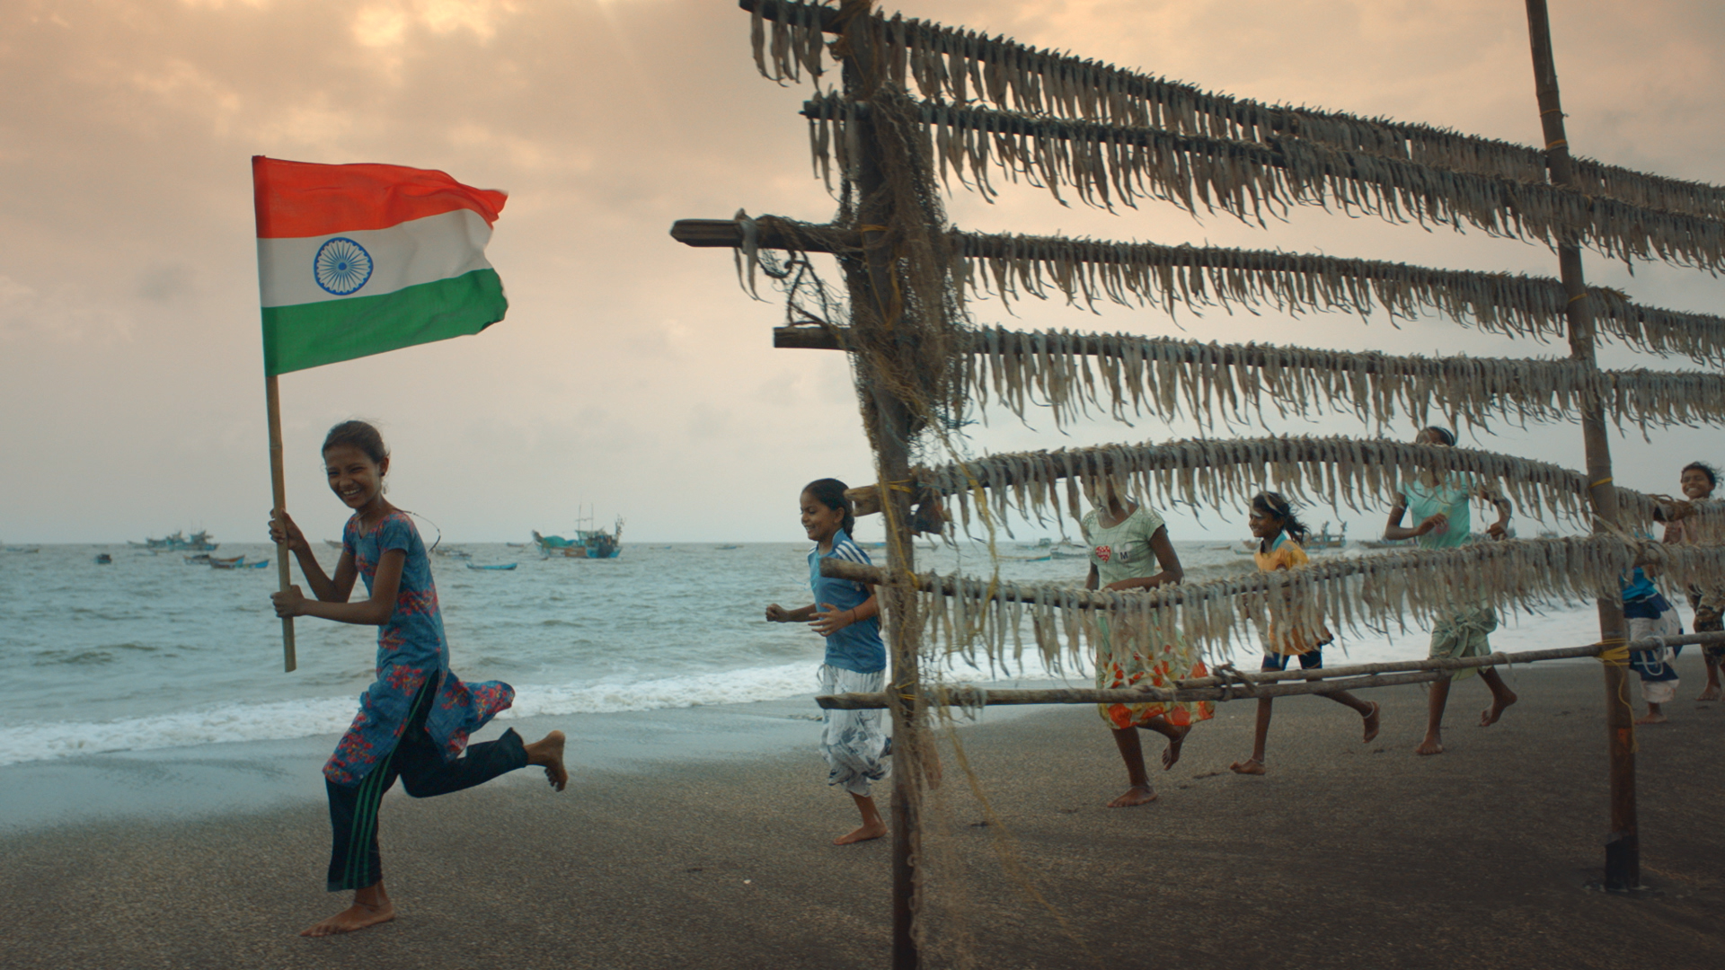
Azadi Ka Amrit Mahotsav (AKAM)
On 12th March, 2021, Nation began a 75-week countdown to the 75th anniversary of Independence from Sabarmati Ashram launched by Hon’ble Prime Minister Shri. Narendra Modi
Azadi Ka Amrit Mahotsav is one of the world’s largest programs of this nature in terms of scope and participation
AKAM programs are based on 5 key themes driving our commemorative and celebratory efforts. (Freedom struggle, Ideas@75, Resolve@75, Actions@75, Achievements@75)
48000+ events, 150+ countries, 28 states, 8 UTs, 55 Ministries, 1 event every 15 minutes

Slide 3
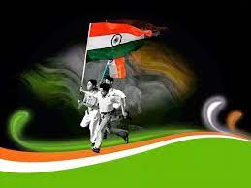
Har Ghar Tiranga (HGT) – Broad Contours
Har Ghar Tiranga campaign planned as a tribute to Indian National Flag under Azadi Ka Amrit Mahotsav
Campaign to encourage citizens to hoist National Flag of India in their homes to mark 75th Independence Day
Instill feeling of patriotism and acknowledge the journey of India in the last 75 years
Selfie with Flag and Pin the Flag on www.harghartiranga.com
Ensure participation of Citizens from all walks of life and age group
Hoisting of Indian National Flag by more than 20 Crore households across India from 13th to 15th August 2022

Slide 4
Har Ghar Tiranga (HGT) – Key Enablers – Changes in Flag Code
Flexibility in Materials permitted for preparation of flags – Polyester, Cotton, Wool, Silk and Khadi bunting material permitted.
Permitted Sizes: Length to Height (Width) Ratio of 3:2 to be maintained. No size restriction.
A member of public, a private organization or an educational institution may hoist/display the National Flag on all days and occasions
Machine Made Flags permitted in addition to Hand-made Flags
No restriction on timing of Flag Display.

Slide 5
Har Ghar Tiranga: Sourcing of Flags
States have mobilized Self Help Groups (SHGs) for production of Flags.
Local Tailoring Units and MSMEs have also been roped in for production of Flags
Ministry of Textiles have identified Flag producers who are supplying Flags in big quantities
All 1.6 Lakh Post Offices in the country shall also make available flag for sale at the last mile
Indicative Flag Sizes and Tentative Price
20” X 30” | Rs 25/-
16” X 24” | Rs 18/-
6” X 9” | Rs 9/-

Slide 6
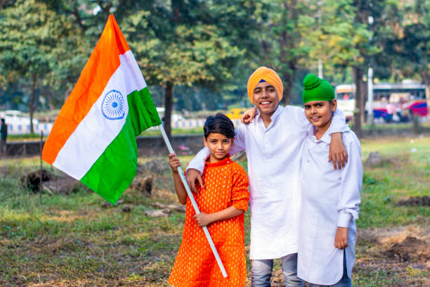
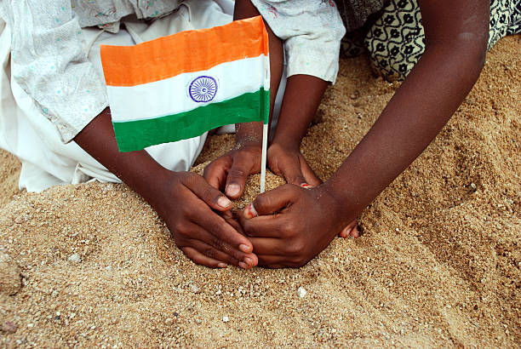
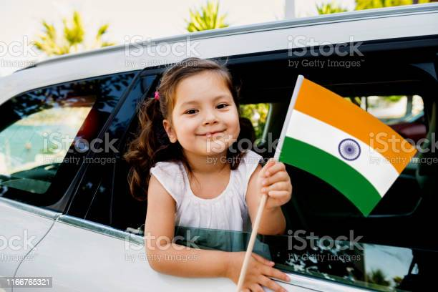
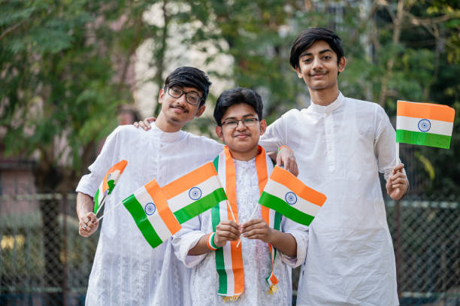
Har Ghar Tiranga: Creating Buzz about the Campaign – Some Pointers
All Higher Education Institutions can be involved in the outreach campaign
Universities/Colleges/Vocational Institutes to be onboarded.
Marathon Runs with Students sporting HGT creatives can be organized from 11th – 15th August
Events and Activities centered around Tiranga may be organized with each event dedicated to a particular aspect of Tiranga
Campaign creatives to be displayed across the Institute Notice-boards.
Institute Vehicles may be painted with HGT Campaign creatives

Slide 7
Har Ghar Tiranga: Involving Alumni Associations in the campaign
Alumni Associations of Higher Education Institutes can be a major vehicle for outreach for the campaign
Alumni Associations can also be roped in for facilitating supply of Flags
Pan-IIT, Pan-IIM and other University and Institute alumni associations can be roped in for popularizing the campaign
Some of the Alumni Associations have presence across the Globe; their members can be contacted for spreading the campaign across the Globe

Slide 8
Indicative listings of Indian National Flag on e-Commerce Platforms
Schools may utilize e-Commerce platforms for supply of Flags. Some indicative listings are as follows
Flipkart: https://dl.flipkart.com/dl/jamboree-indian-national-flag-satin-cloth-24-x-36-inches-rectangle-outdoor/p/itm8f9876656960b?pid=FLAGFPJNRVKK9BGZ&cmpid=product.share.pp&_refId=PP.5b2bcfcf-02b0-48f3-b094-1e393a1acab1.FLAGFPJNRVKK9BGZ&_appId=CL
IndiaMart: https://m.indiamart.com/proddetail/4-x-6-ft-indian-national-flag-outdoor-100-pure-cotton-15169590173.html
Etsy: https://www.etsy.com/in-en/listing/1015116564/india-flag-5-x-3-ft-100-polyester-with?ref=share_v4_lx
National Flag Shop: https://nationflagshop.com/
Amazon: https://amzn.eu/d/0ezSoOv

Slide 9
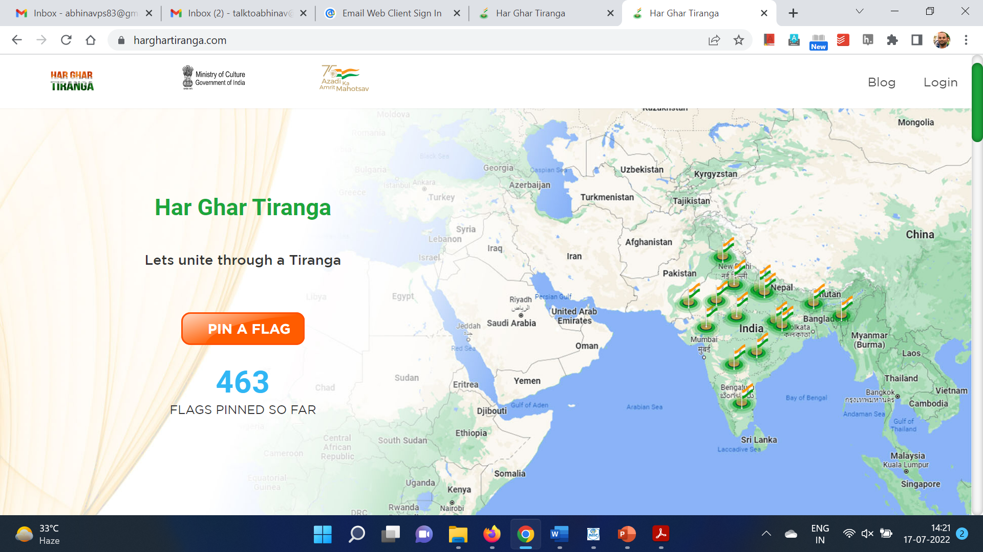
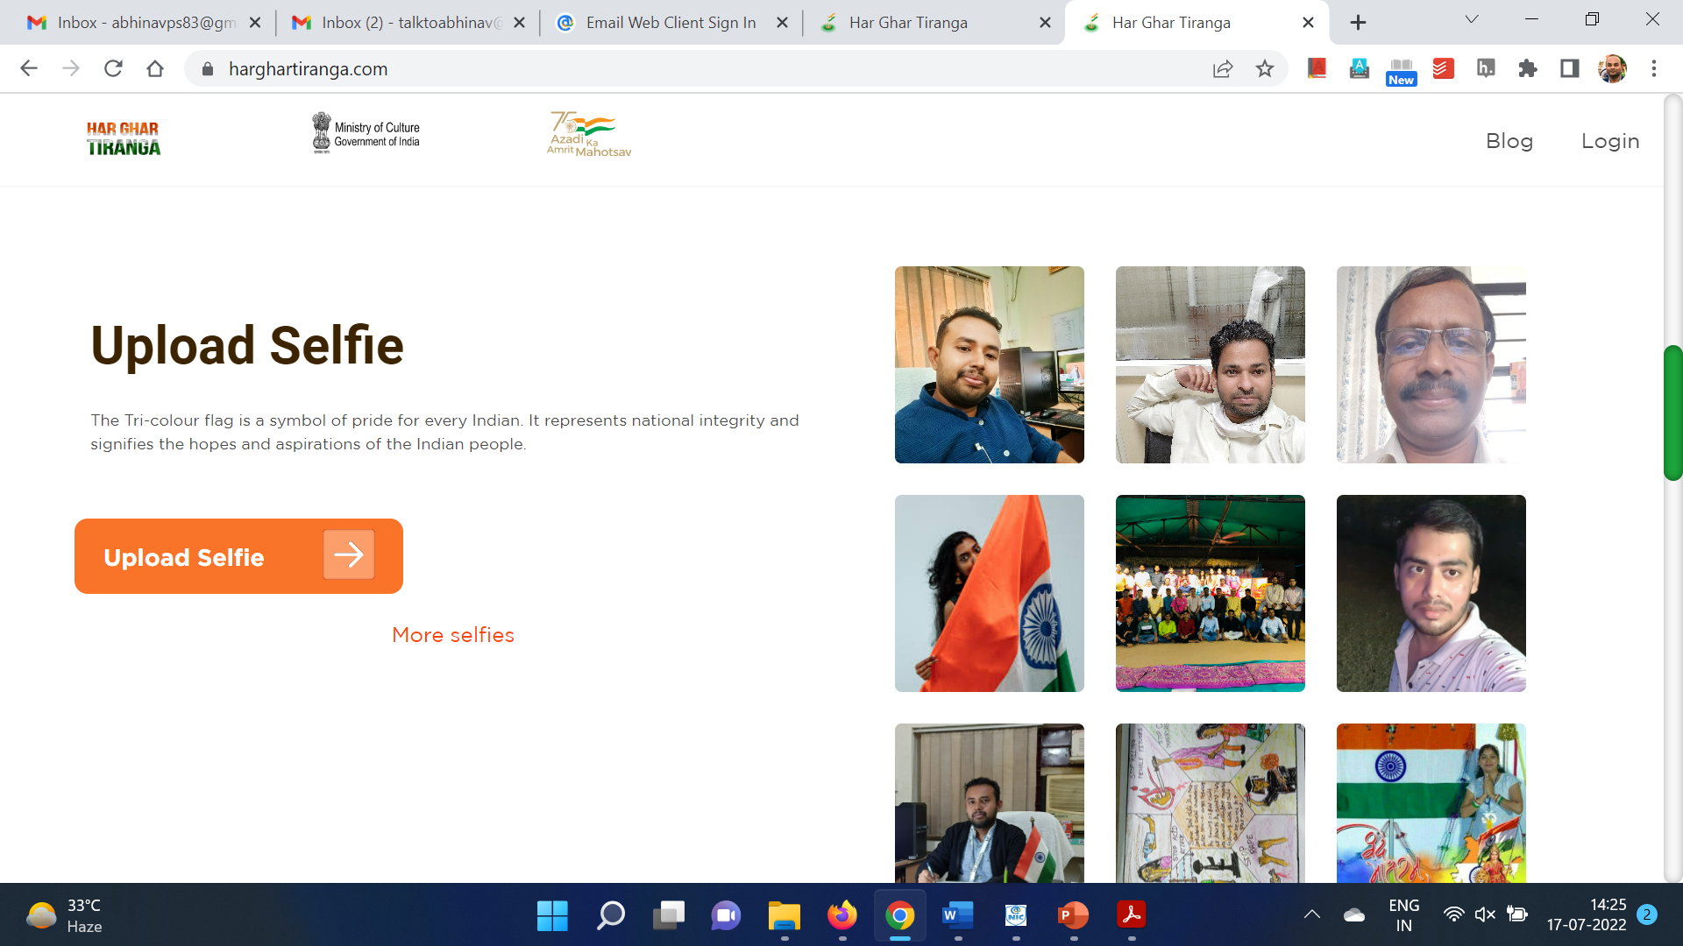
Har Ghar Tiranga Website: https://harghartiranga.com
Har Ghar Tiranga Website created for engaging participants under the campaign
Information about Flag shall be made available including Creatives and Flag Supplier details – Min/Dept may use the same
“Selfie With Flag” Corner for uploading people to upload photographs with Flag
Pin a Flag: Citizens can Pin a flag on the website based on their Geographical Coordinates
All Institutes may ensure that Students Pin the Flag and upload Selfie with Flag on the Website/Social Media Platforms

Slide 10
Other Important Points regarding the Campaign
All Websites/Social Media pages of Institutes/Universities/Colleges may be updated with Har Ghar Tiranga Campaign creatives such that click would redirect visitors to https://www.harghartiranga.com
All Institutes/Universities/Colleges may ensure that all Teachers/Staff/Students have access to Flags.
Institutes/Universities/Colleges may illuminate their buildings in Tri-color during Independence Week. Hoisting/Display of Flags during the campaign from 13th to 15th August
Har Ghar Tiranga campaign has been officially launched with Hon’ble PM’s Tweet on 22nd July.
All employees/students may be directed to update Selfie with Flag on the Har Ghar Tiranga Website. Simultaneously, they may Pin the Flag on the website as per their Geographical coordinates

Slide 11
Thank you

